Slide 1
Image Transformation 4/30/2009
Omar Oreifej

Slide 2
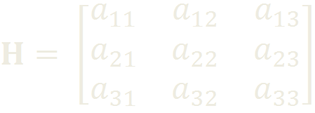
Image Transformation

Slide 3
Process
Input:
I(x, y, c)
H
Output:
I’(x, y, c)
Steps:
Calculate size of I’
Transformation of border points
Empty transformed image
H
I
I’

Slide 4
Process
Compute H⁻¹
For every pixel in I’(x, y, c)
{
Find source pixel/s
If (source is within I)
Interpolate pixel value
Else
Assign pixel value to zero
}
H⁻¹
I
I’

Slide 5
Implementation
OpenCV
Image Reading/Writing and visualization
Host side:
Calculate transformed image size
Calculate (H⁻¹)
Prepare inputs/outputs
Kernel side:
Thread per pixel
Calculate pixel source
Obtain pixel value

Slide 6
Optimizations
Compute all pixel’s channels in the same thread
Increased thread utilization
Less CPU-GPU reads/writes
Shared H⁻¹
Less memory access latency
Performance

Slide 7
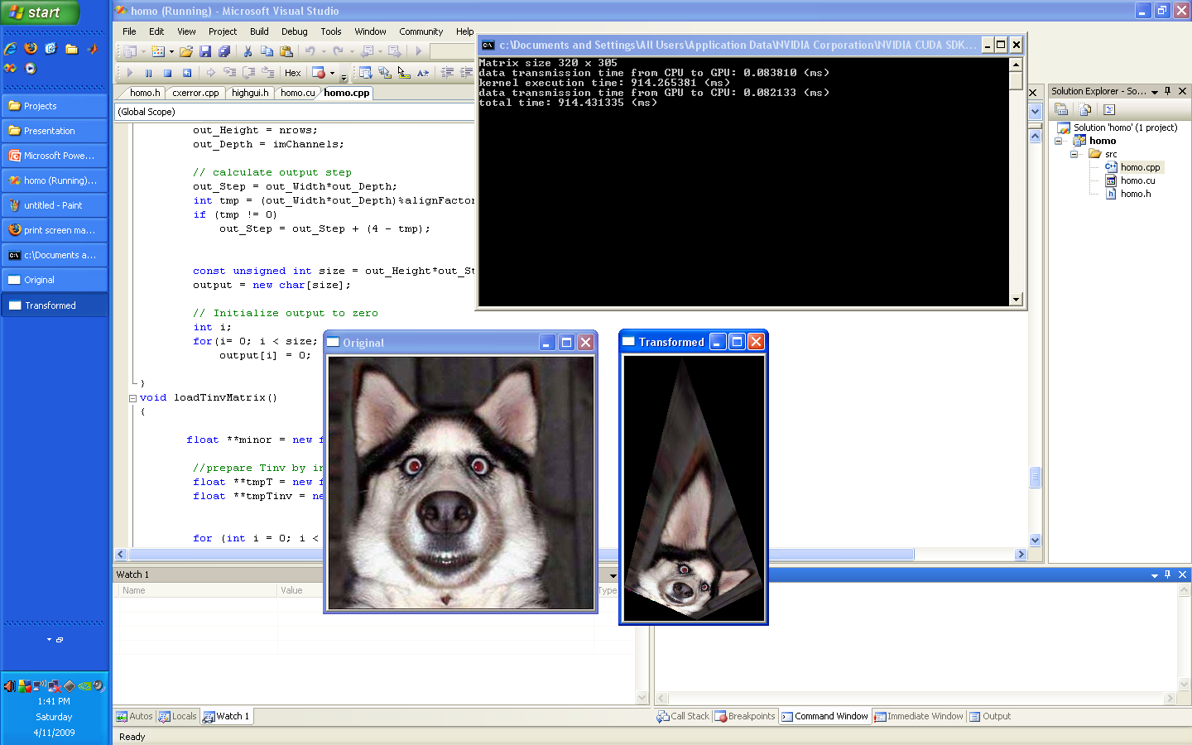
Screenshot

Slide 8
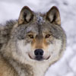
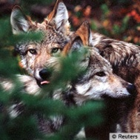
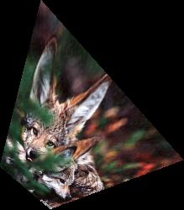
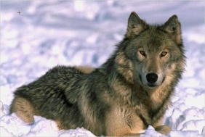
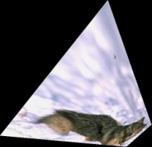
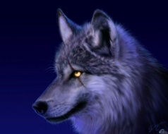
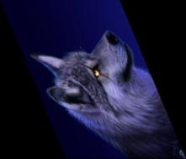
Results
Original | Transformed | Size | CPU time(ms) | GPU time(ms) | Ratio CPU/GPU
 |  | 50x50 = 2500 | 25 | 8.86 | 2.82
 |  | 100x100 = 10000 | 97 | 28.53 | 3.4
 |  | 250x250 = 62500 | 200 | 48.78 | 4.1
 |  | 500x336 = 168000 | 521 | 121.16 | 4.3
 |  | 1024x768 = 786432 | 1910 | 313.11 | 6.1

Slide 9
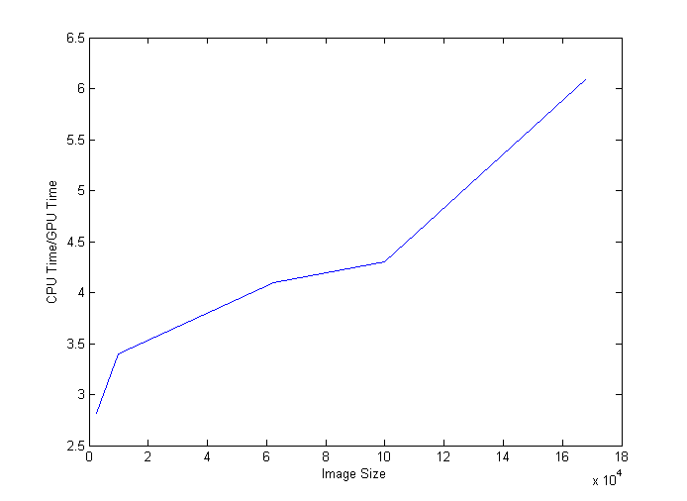
Results
CPU: Intel Core Due 2 – 9300
GPU: Nvidia 8600M GT

Slide 10
Thank You

