Slide 1
Image matching using the Hausdorff Distance with CUDA
Ashish Shah

Slide 2
Hausdorff distance
set A = {a1,….,ap} and B = {b1,….,bq}
- maximum distance of a set to the nearest point in the other set.
- So in effect ranks each point of A based on its distance to the nearest point of B, and then uses the largest ranked such point as the distance
- Hausdorff distance measures the amount of mismatch between two sets of points.
- computed in O(pq(p+q)log(pq)) time

Slide 3
Minimal Hausdorff distance
Considers the mismatch between all possible relative positions of two sets
Minimal Hausdorff Distance M_{G} defined as for all transformations(G)
In the paper referred and project the focus is on the case where the relative position of the model with respect to the image is the group of translations

Slide 4
How to compute the M_{T}
  In other words the H(A,B) can be computed by computing d(a) and d’(b) for all and
  Interested in the graph of d(x)
  which gives the distance from any point x to the nearest point in a set of source points in B

Slide 5
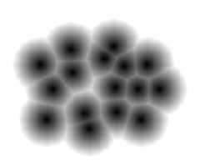
Voronoi surface
It is a distance transform
It defines the distance from any point x to the nearest of source points of the set A or B

Slide 6
Calculating Vornoi surfaceArray D [x,y]
Algorithm
  Process each row independently
for each row calculate distance to nearest non-zero pixel in that row
i.e. for each (x,y) it finds dx such that E[x+dx, y] or E[x-dx,y] is a non-zero pixel where dx is minimum non-negative number
  Then scan each column up and down using the above computed dx values and using Euclidean norm calculate the nearest non-zero-pixel distance

Slide 7
Calculating Vornoi surfaceArray D [x,y]

Slide 8
Calculating Vornoi surfaceArray D [x,y]
// x- KERNEL OVERVIEW
for l = 0 to imagewidth
if d[l] == infinity
{
for k = l+1 to imagewidth
if d[k] == 0
distance = k - l
for k = l-1 to 0
if d[k] == 0 && (l-k) < distance
distance = l - k
}
d[l] = distance

Slide 9
Calculating Vornoi surfaceArray D [x,y]
// y-KERNEL OVERVIEW
for l = 0 to imageheight
origdistance = d[l]
distance = origdistance
if d[l] != 0
{
for k = l+1 to imageheight
if (d[k] != infinity) && floord[k] == d[k]
distance = k -l
else
geteuclideandistance(k-l, d[k])
for k = l-1 to 0
if d[k] != infinity && floord[k] == d[k]
{
tdistance = 0;
if d[k] == 0 tdistance = l - k
else tdistance = geteuclideandistance(l-k, d[k])
if tdistance < distance
diatnce = tdistance
}
}
d[l] = distance

Slide 10
Calculating Vornoi surfaceArray D [x,y]

Slide 11
Vornoi surfaceArray run-time comparison

Slide 12
Vornoi surfaceArray run-time comparison

Slide 13
Vornoi surfaceArray run-time comparison

Slide 14
Vornoi surfaceArray computation (nice to have)
Using Shared memory by cell decomposition technique
Verifying or comparing results by using Z-buffer for calculations, claims O(P) runtime in paper
Author states takes 1 sec to compute distance transform on Sun-4 (SPARC-2 machine) for 256x256 image, no results for bigger images, our results show considerable degradation for higher resolution images

Slide 15
Calculating Hausdorff distance array F [x,y]
Algorithm
F[x,y] can be viewed as the maximization of distance transform D’[x,y] shifted by each location where model B[k,l] takes a nonzero value
Probing the Voronoi surface of the image
i.e. locations in the Voronoi surface of the image are probed and then F[x,y] is the maximum of these probe values for each position (x,y) of the model B[k,l].

Slide 16
Calculating Hausdorff distance array F [x,y]

Slide 17
Calculating Hausdorff distance array F [x,y]
// hausdorffArrayKernel
for k = 0 to modelheight
for l = 0 to modelwidth
element = M[l][k] * I[lx][ky]
if (element > distance)
{
distance = element
}
d[o] = distance
Notes:
17

Slide 18
Calculating Hausdorff distance array F [x,y]

Slide 19
Calculating Hausdorff distance array F [x,y]

Slide 20
Calculating Hausdorff distance array F [x,y]

Slide 21
Calculating Hausdorff distance array F [x,y]

Slide 22
Calculating Hausdorff distance array F [x,y] (nice to have)
Using shared memory with cell decomposition technique
Verifying technique with Z-buffer calculations, paper hasn’t verified this technique as well, mentions repeated Z-buffer loading could hamper the faster results as well
Efficient computation as described for CPU O(pq(p+q)logpq)
  Ruling out circles
  Early scan termination
  Skipping forward
  Mentions consideration between speedup methods important

Slide 23
Results extracted from paper (efficient computation)
Image: 360 x 240 pixels
Model: 115 x 199 pixels
Sun-4 (SPARCstation 2)
Runtime ± 20 seconds
2 matches
Image
model
overlaid

Slide 24
Results from CUDA implementation
  As per slide 15
  - naïve approach
  - 256x256 image
  - 256x256 model
  - 13 seconds
  Results show that for higher resolution images the timing doesn’t de-grade much wheras on CPU implementation suffers exponential degradation
  Currently working on taking an actual binary image as input and doing a compare, planning on finishing implementation before end of project
  Note this should have very little to no effect on our results reported

Slide 25
Comments
The method is quite tolerant of small position errors as occur with edge detectors and other feature extraction methods but a single outlier could throw the results off.
Partial Hausdorff Distance is the k-th ranked distance between a point and its nearest neighbor in the other set where distances are ranked in increasing order
- nicely resistant to noise
- need to figure out kth distance value
Nice to do also:
Comparing multi-resolution image match techniques
Comparing images under rigid motion

Slide 26
References
References
  [Huttenlocher et al., 1991]
  Huttenlocher Daniel P, Kedem K and M. Sharir
  The Upper Envelope of Voronoi Surfaces and Its Applications, ACM symposium on Computational Geometry,194-292, 1991
  Huttenlocher, D. P., Klanderman, G. A., and Rucklidge, W. A. 1993. Comparing Images Using the Hausdorff Distance. IEEE Trans. Pattern Anal. Mach. Intell. 15, 9 (Sep. 1993), 850-863.
  Rucklidge, W. J. 1994 Efficient Computation of the Minimum Hausdorff Distance for Visual Recognition. Technical Report. UMI Order Number: TR94-1454., Cornell University.

Slide 27
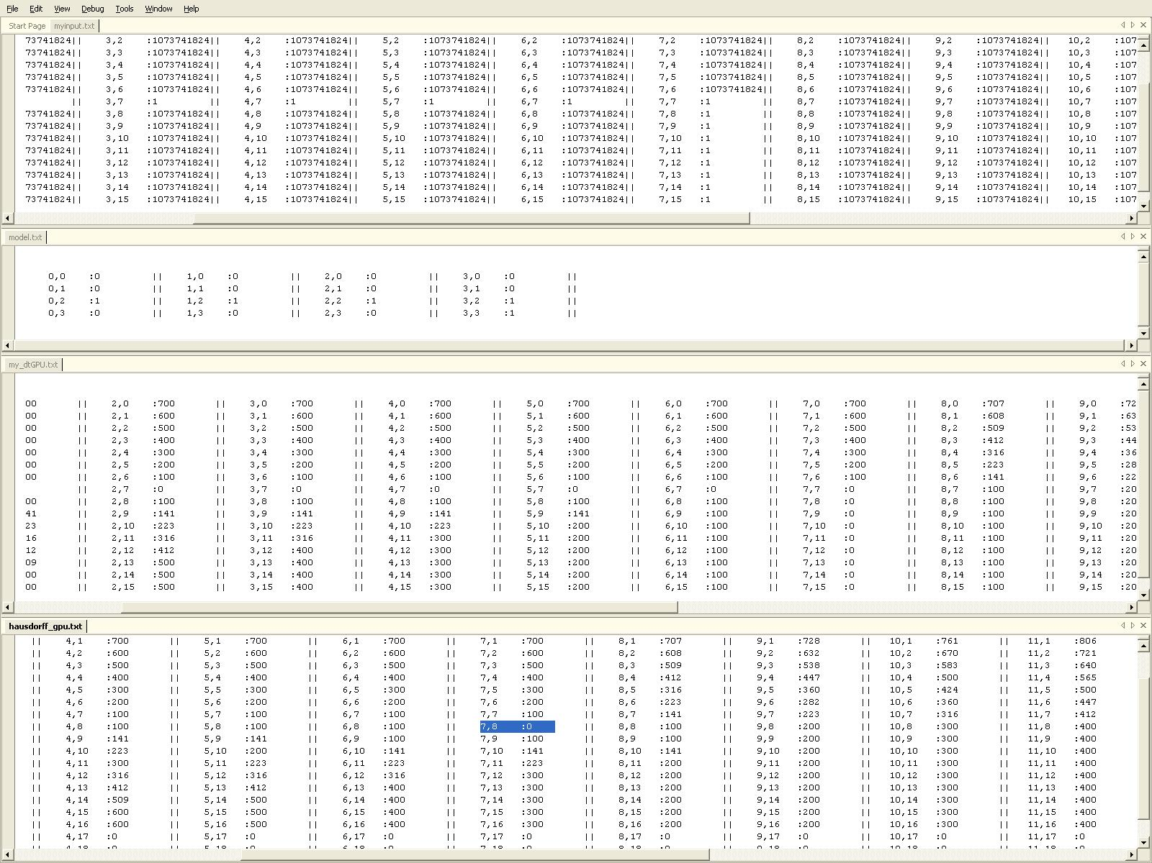
Comments

Slide 28

Comments

