Slide 1
Fast Background Subtraction using CUDA
Janaka
CDA 6938

Slide 2
What is Background Subtraction?
Identify foreground pixels
Preprocessing step for most vision algorithms
Notes:
Vision algo – step in pipeline

Slide 3
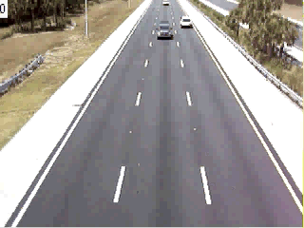
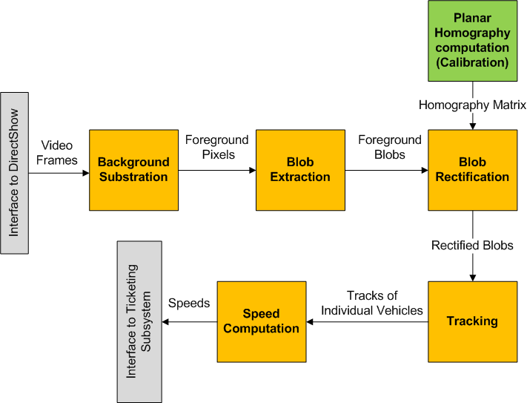
Applications
Vehicle Speed Computation from Video

Slide 4
Why is it Hard?
Naïve Method |frame_{i} – background| > Threshold
Illumination Changes
Gradual (evening to night)
Sudden (overhead clouds)
Changes in the background geometry
Parked cars (should become part of the background)
Camera related issues
Camera oscillations (shaking)
Grainy noise
Changes in background objects
Tree branches
Sea waves

Slide 5
Current Approaches
Frame Difference | frame_{i} – frame_{(i-1)} |> Threshold
Background as the running average
B_{i+ 1}= α* F_{i}+ (1 -α) * B_{i}
Gaussian Mixture Models
Kernel Density Estimators

Slide 6
Gaussian Mixture Models
Each pixel modeled with a mixture of Gaussians
Flexible to handle variations in the background

Slide 7
GMM Background Subtraction
Two tasks performed real-time
Learning the background model
Classifying pixels as background or foreground
Learning the background model
The parameters of Gaussians
Mean
Variance and
Weight
Number of Gaussians per pixel
Enhanced GMM is 20% faster than the original GMM*
* Improved Adaptive Gaussian Mixture Model for Background Subtraction , Zoran Zivkovic, ICPR 2004

Slide 8
Classifying Pixels
= value of a pixel at time t in RGB color space.
Bayesian decision R – if pixel is background (BG) or foreground (FG):
Initially set p(FG) = p(BG), therefore if
decide background
= Background Model
= Estimated model, based on the training set X

Slide 9
Definitions and Assumptions
= value of a pixel at time t in RGB color space.
Pixel-based background subtraction involves a decision if the pixel belongs to background (BG) or foreground object (FG).
Bayesian decision R is made by:
We set p(FG) = p(BG) , assuming we don’t know anything about the foreground objects and assume uniform distribution for the foreground object appearance. Therefore, if
decide that pixel belongs to background
= Background Model
= Estimated model, based on the training set X

Slide 10
The GMM Model
Choose a reasonable time period T and at time t we have
For each new sample update the training data set
Re-estimate
Full scene model (BG + FG)
GMM with M Gaussians where
- estimates of the means
- estimates of the variances
- mixing weights non-negative and add up to one.

Slide 11
The Update Equations
Given a new data sample update equations
where,
is set to 1 for the ‘close’ Gaussian and 0 for others
and is used to limit the influence of old data (learning rate).
An on-line clustering algorithm.
Discarding the Gaussians with small weights - approximate the background model :
If the Gaussians are sorted to have descending weights :
where c_{f} is a measure of the maximum portion of data that can belong to FG without influencing the BG model

Slide 12
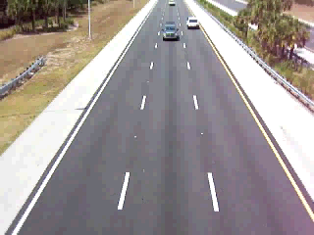
Background Subtraction Results
Original Video
Foreground Pixels

Slide 13
CPU/GPU Implementation
Treat each pixel independently
Use the “Update Equations” to change GMM parameters

Slide 14
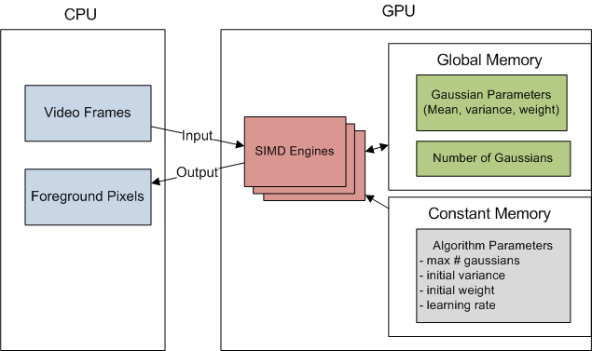
How to Parallelize?
Simple: One thread per pixel
Each pixel has different # of Gaussians
Divergence inside a warp

Slide 15
Preliminary Results
Speedup: mere 1.5 X
QVGA(320 x 240) Video
Still useful since CPU is offloaded

Slide 16
Optimization
Constant Memory
Pinned (non pageable) Memory
Memory Coalescing
Structure of Arrays Vs Array of Structures
Packing and Inflating Data
16x16 block size
Asynchronous Execution
Kernel Invocation
Memory Transfer
CUDA Streams

Slide 17
Memory Related
Constant Memory
Cached
Used to store all the configuration parameters
Pinned Memory
Required for Asynchronous transfers
Use “CudaMallocHost” rather than “malloc”
Transfer BW for GeForce 8600M GT using “bandwidthTest”
 | Pageable | Pinned
CPU to GPU | 981 MB/s | 2041 MB/s
GPU to CPU | 566 MB/s | 549 MB/s

Slide 18
CUDA Memory Coalescing (recap)*
A coordinated read by 16 threads (a half-warp)
A contiguous region of global memory:
64 bytes - each thread reads a word: int, float, …
128 bytes - each thread reads a double-word: int2, float2
256 bytes – each thread reads a quad-word: int4, float4, …
Starting address must be a multiple of region size
* Optimizing CUDA, Paulius Micikevicius

Slide 19
Memory Coalescing
Compaction – uses less registers
Inflation – for coalescing

Slide 20
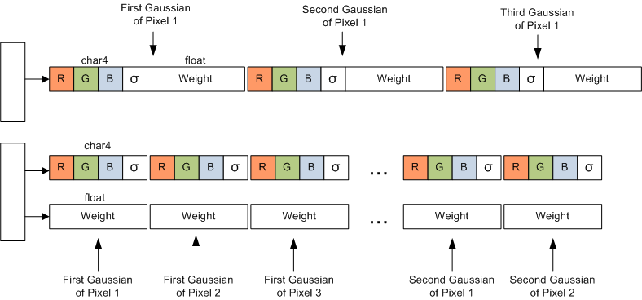
Memory Coalescing
SoA over AoS – for coalescing

Slide 21
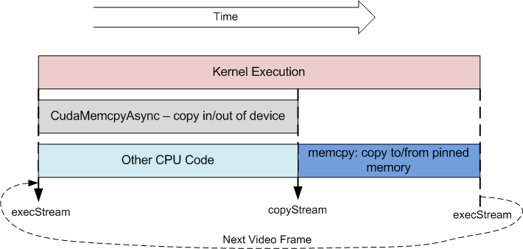
Asynchronous Execution

Slide 22
Asynchronous Invocation
int cuda_update(CGMMImage2* pGMM, pUINT8 imagein, pUINT8 imageout)
{
//wait for the previous memory operations to finish
cudaStreamSynchronize(pGMM->copyStream);
//copy into and from pinned memory
memcpy(pGMM->pinned_in, imagein, ....);
memcpy(imageout, pGMM->pinned_out, ....);
//make sure previous exec finished before next memory transfer
cudaStreamSynchronize(pGMM->execStream);
//swap pointers
swap(&(pGMM->d_in1), &(pGMM->d_in2));
swap(&(pGMM->d_out1), &(pGMM->d_out2));
//copy the input image to device
cudaMemcpyAsync(pGMM->d_in1, pGMM->pinned_in, ...., pGMM->copyStream);
cudaMemcpyAsync(pGMM->pinned_out, pGMM->d_out2, ...., pGMM->copyStream);
//call kernel
backSubKernel<<<gridB, threadB, 0, pGMM->execS>>>(pGMM->d_in2, pGMM->d_out1, ...);
return 0;
}

Slide 23
Gain from Optimization
Observe how the running time improved with each optimization technique
Naïve Version (use constant memory)- 0.110 seconds
Partial Asynchronous Version (use pinned memory) - 0.078
Memory coalescing (use SoA) - 0.059
More coalescing with inflation and compaction - 0.055
Complete Asynchronous - 0.053

Slide 24
Experiments - Speedup
Final speedup 3.7 X on GeForce 8600M GT

Slide 25
Frame Rate
481 fps – 256 x 256 video on 8600M GT
HD Video Formats
720p (1280 x 720) – 40 fps
1080p (1920 x 1080) – 17.4 fps

Slide 26
Foreground Fraction
Generate video frames with varying numbers of random pixels
GPU version is stable compared to CPU version

Slide 27
Matlab Interface (API)
Interface for developers
Initialize
h = BackSubCUDA(frames{1}, 0, [0.01 5*5 1 0.5 gpu]);
Add new frames
for i=1:numImages
output = BackSubCUDA(frames{i}, h);
end;
Destroy
clear BackSubCUDA

Slide 28
Conclusions
Advantages of the GPU version (recap)
Speed
Offloading CPU
Stability
Overcoming the Host/Device transfer overhead
Need to understand optimization techniques

